Slide 1


ARIZONA FAITH COUNCIL
Refugees, Mental Health,
Poverty & More
--------
How Disability Impacts
All of Us and What We Can Do About It
Notes:
Presented by Erica McFadden, Executive Director, AZ Developmental Disabilities Planning Council; Traci Gruenberger, Council member and Director of Mosaic

Slide 2

Sizeable Minority
1. Hispanic or Latino: 30.3%
2. People w/ disabilities (PWD): 12.2%
3. Some other race alone: 6.5%
4. American Indian and Alaskan
Native alone: 4.4%
5. Black or African American: 4.1%
*** Of 800,210 PWDs, an estimated 117,600 have developmental disabilities (DD)
*** At least 30% of Arizonans either have a disability (6%) or care for someone with disability (14%)
(1(ACS 2011-2015)
Notes:
Unaddressed disability issues contribute to many of Arizona’s top policy challenges due to their sheer numbers and over-representation in poor socioeconomic indicators.
According to the findings of a fall 2015 Morrison Institute poll, more than 2.2 million people are personally and directly impacted by disability in Arizona. That’s one in three people.
Arizona’s population with disabilities is the second-largest minority group after Latinos, and 14 percent of Arizonans are the primary caregiver to someone with a disability. And it’s not just an aging issue. In Arizona public schools, more than 11 percent of students have a disability.
Going to discuss several key issues we as a Council have decided to Council, why we are tackling them, and how you can help. This is a discussion so chime in throughout.

Slide 3


We need YOUR expertise to provide solutions

Slide 4
The Disability Gap
With Disability
No Disability
Employment rate
(age 18-64)
60.4%
34.8%
Not in labor force
59.5%
16.9%
Median earnings 16yo+
$21,917
$31,111
Below 100% of poverty level
19.1%
13.5%
(1(ACS 2016)
Notes:
One of our biggest barriers is employment. With regards to overrepresentation among negative quality of life indicators, 2016 Census numbers in Arizona show that only one in three working-age adults with disabilities are employed and about one in five live in poverty.
Further, the fall 2015 Morrison Institute poll shows that expectations are generally less for people with disabilities among all Arizonans. On one hand, the majority of Arizona voters are comfortable with hiring people with disabilities (80 percent), would have a more favorable opinion of an employer who recruited them (75 percent), and would prefer to give their business to companies who hire them (78 percent). But, on the other hand, many do not believe, or do not know, if workers with disabilities could perform at the same level as workers without disabilities.
When Arizonans were asked if they agreed with the statement, “Workers with disabilities perform at the same level as their counterparts,” 42 percent said they could perform at the same level, 40 percent said they could not, and 18 percent said they simply didn’t know.
Among DDD clients, the few that are working are making subminimum wages averaging $5/hour. Expectations are generally low among and regarding this population.

Slide 5
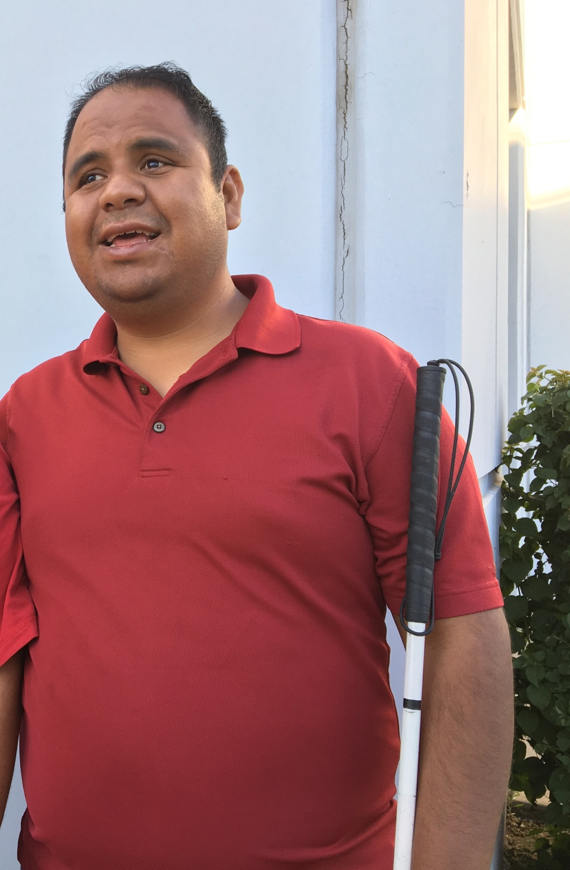
How the Council wants to reach these communities
We want to fund:
Pilot projects centered around
Training to Hire
for people with disabilities
Sebastian – Self-employed
Mesa, AZ

Slide 6

How the Council wants to reach these communities
We want to fund:
Pilot projects for coding academies, robotics skills, etc. for those who can’t afford it
UAT/SARRC – Geek Tech Camp

Slide 7


The faith community
knows better than anyone…
There’s a
crisis in caregiving
Notes:
48% turnover in last 12 months according to a 2015 Staff Stability Survey and a 9.5% vacancy rate.

Slide 8

How the Council wants to reach these communities
We want to explore:
Pilot projects
that train people with disabilities as direct care workers

Slide 9
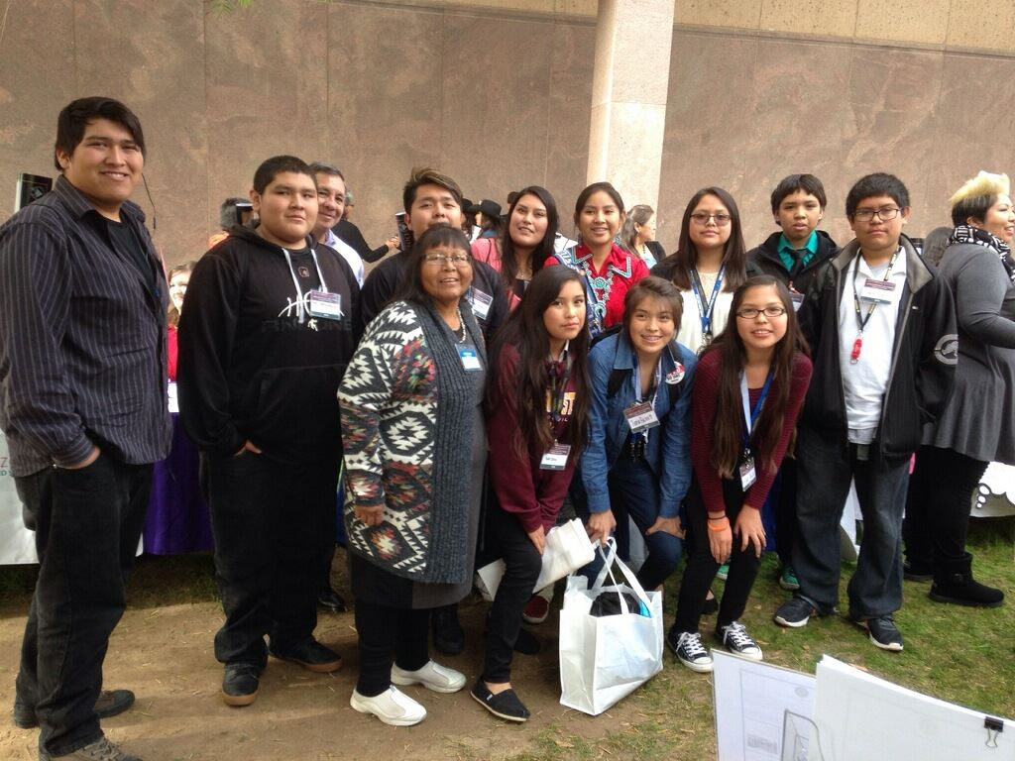
Tribal Communities
Have the highest rate of disability of all minority groups in Arizona (13.4%) and the most barriers to access
Angelina and youth from
her Hopi Tribe

Slide 10
9.2%
of Arizona residents don’t speak English very well
  27.0% Santa Cruz
  23.3% Yuma
  9.5% Maricopa County
(1(ACS 2011-2015)

Slide 11
Refugees in Arizona
Arizona is the 7th highest refugee receiving state;* 35% need medical attention within first 4-6 weeks**
*Refugees and Asylees in the United States, Migration Policy Institute, June 7, 2017
**The IRC Medical Needs Statement
Notes:
In 2015, an intern from Greater Valley Area Health Education Center (GVAHEC) conducted an analysis of the IRC’s health efficacy outcomes. The study examined 681 individuals, 300 of which had bio-data indicating medical need. The IRC’s databases indicate that 48% of refugees need medical assistance upon arrival, and 35% of all arrivals in Phoenix have a need for medical attention within the first 4-6 weeks. Many refugees resettled in Phoenix have never been to the doctor before, and 68% of IRC’s newly arrived refugees have a primary school education or below. Lack of healthcare literacy. American healthcare system is highly complex. Successful navigation of medical referrals, insurance stipulations, coordination of travel for the disabled, and proper interpretation services create a web that most American citizens have a hard time navigating.

Slide 12
How the Council wants to reach these communities
We want to:
Research how well disability and refugee services work together and where there are current gaps

Slide 13
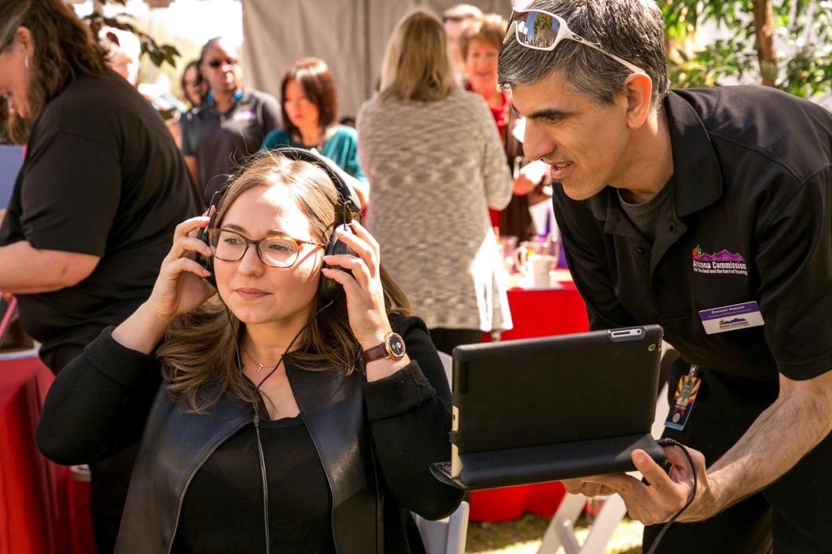
The Council leading efforts to be more responsive to culturally & linguistically diverse communities
Hispanics and Latinos
Tribal communities
Deaf and Hard of Hearing
Refugees
Notes:
Over the next five years, working with Georgetown University and leaders from DDD, RSK, ACDL, Sonoran UCEDD, and IHD at NAU to start a community of practive targeting these efforts in orgs and agencies across AZ.

Slide 14

Arizona ranks #50 in Mental Health
Populations Impacted:
Foster Care
Juvenile and Adult Corrections
First Responders
MH Provider Network
Individuals with autism
Notes:
Mental Health America ranks Arizona #50 overall in their 2017 State of Mental Health Report
Previous research also indicates that children with disabilities are at least 1.7 times more likely to be abused or neglected; in Arizona, 30 percent of children in foster care have disabilities. The Arizona SB 1375 report released in 2014 ndicates that youth with disabilities have a higher number of out-of-home placements on average and are less likely to have a concurrent plan for their permanency outcomes than their non-disabled peers. They make up the majority of older youth in foster care and a substantial proportion of all children and youth in the child welfare system.
In August 2017, Arizona’s adult state correction inmate counts report more than one in four (27.9 percent) inmates require on-going mental health treatment. Among juveniles incarcerated in August 2017, 29.4 percent received mental health visits and 30.6 percent were enrolled in special education
Among those arrested who were in MH crisis: 71% of those taken to jail reported that there were no questions asked about their mental health or there was any mental health assistance provided. On the other hand, officers reported that they were almost three times more likely to release someone in crisis or almost twice as likely take them to a mental health agency than they were to jail. Lack of autism training. Lack of BH training in autism.

Slide 15
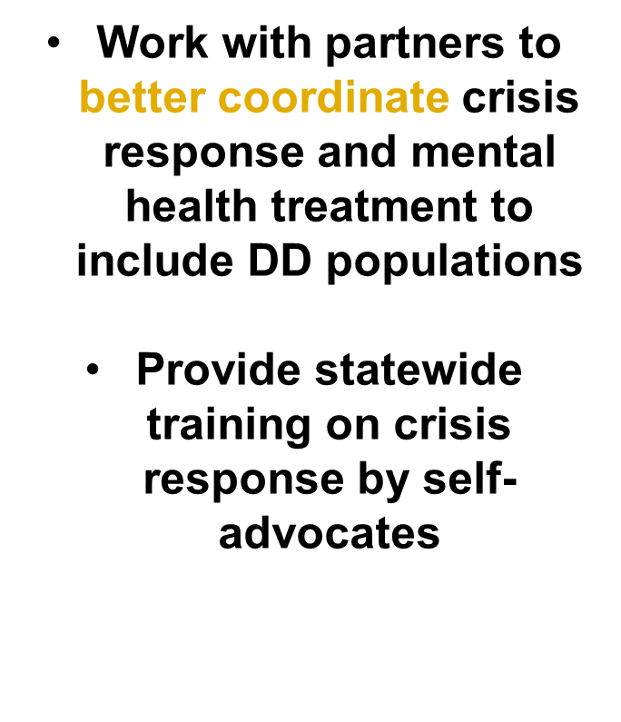

The Council wants to:
FIRST RESPONDERS’ ACTIONS ARE KEY!

Slide 16
Most live at home, unaware of other options… as families age
Percentage of Arizonans with ID/DD by Residential Setting
(June 30, 2016)
Notes:
AZ is ranked #1 for supporting people I their own homes. The concern lies in what happens with the parents age? Where does the love one go? Group homes tend to be referred to the most, although most expensive and restrictive option.
Group Homes
Congregate living with up to 5 people, depending on bedrooms
Lease/Mortgage is in the name of the agency
Agency staff provide support services 24 hours a day
24 hour awake staff care is provided
Choices are limited due to staffing constraints and number of people
Instead, we need to better under Community Based Housing Options out there:
Individually Designed Living Arrangements (IDLA)
Housing option for between 1 and 3 people with a developmental disability
People determine who, if anyone, they want to live with
Lease/Mortgage is in the name of the person with a developmental disability or their responsible party
Repairs/maintenance/upkeep of property are the responsibility of the property owner or as outlined in the lease
Agency staff provide support services from a few hours per day to 24 hours per day
Staff teach skills outlined in Individual Support Plan (ISP)
Adult/Child Developmental Homes (Host Homes)
Housing option for between 1 and 3 people with a developmental disability
Homes and Providers are licensed through the State of Arizona Office of Licensure, Certification and Registration (OLCR)
Agency licenses and monitors homes
Lease/Mortgage is in the name of the community provider
Community provider under contract with agency
Providers teach skills outlined in Individual Support Plan (ISP)
Individual becomes an integral part of the household
High continuity of support as same providers 24/7/365

Slide 17
Planning for the Future
The Council publishes material and educates on:
Housing options
ABLE Accounts
Guardianships
How to plan ahead

Slide 18
Adults Aren’t Speaking Up Either
Notes:
Among so many unknowns and in this climate of lower expectations, the importance of speaking up for oneself is critical. Yet, a 2015 survey of individuals with disabilities found that the majority (51 percent) doesn’t speak up for themselves. What’s worse, 38.5 percent of them said that no one speaks up for them.

Slide 19

One answer to Learning How to Speak Up?
http://azsilc.org/az-cla/
Notes:
We are partnering with the statewide independent living council to promote leadership trainings for people with disabilities. & then connecting them with leadership opportunities in the community.

Slide 20
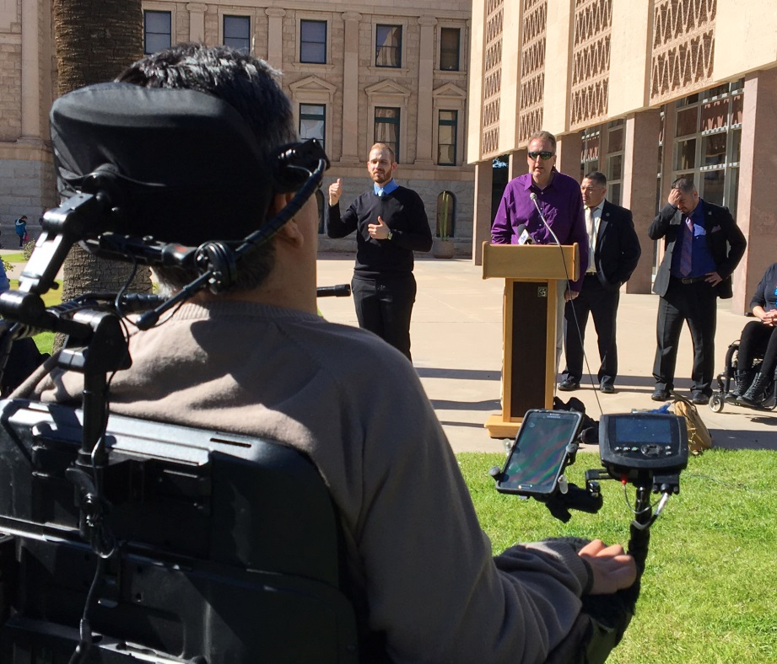
Speaking up for themselves
Historically, the faith community were leaders in recognizing people with disabilities…
but when it comes to
self-advocacy, we can do better.
Notes:
We are seeking people with disabilities to serve on nonprofit boards, city councils, parks and recreation commissions, any leadership role!

Slide 21

What Can YOU Do?
Ensure programs, staff, and leadership positions are inclusive and accessible to people with disabilities
Sign up to be on our mailing list for grant solicitation alerts
Meet with us to identify ways we can collaborate
Notes:
How do you involve PWDs in your programs? Leadership? Volunteer and work opps?

Slide 22
THANK YOU!
emcfadden@azdes.gov
Traci.Gruenberger@mosaicinfo.org

